Slide 1

Restaurant and Consumer Database Analysis using SQL
Presented By -
L. NANDINI
R. SINDHU

Slide 2
Agenda (This should be the PPT flow)
Project Overview
Database Design
Database Tables
Sample Data
SQL Queries & Analysis
Conclusion

Slide 3
Project Overview
The Restaurant Database Management System is a MySQL-based relational database designed to store, manage, and analyse information about consumers, restaurants, cuisines, preferences, and ratings.
The database connects consumers with their preferred cuisines and restaurant ratings while maintaining relationships between restaurants and the cuisines they offer.
Objectives
Manage consumer and restaurant data efficiently
Maintain relationships between different database tables
Ensure data integrity using Primary Keys and Foreign Keys
Analyze consumer preferences and restaurant ratings
Generate meaningful insights using SQL queries

Slide 4
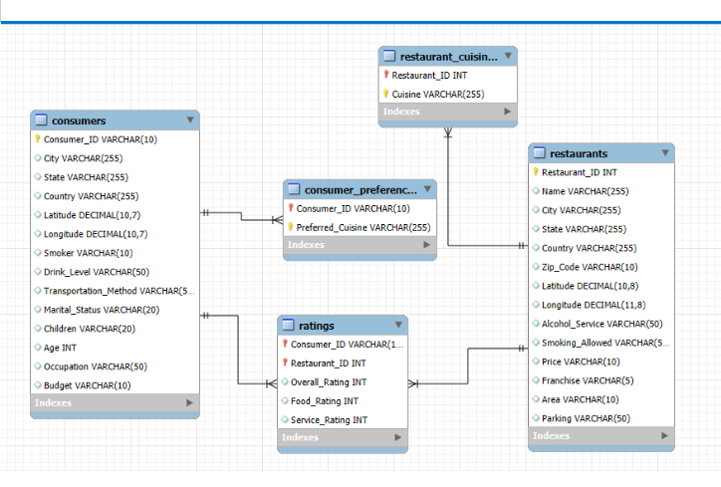
Database Design(ER Diagram)
The project uses restaurant-related datasets containing information about consumers, consumer preferences, restaurants, restaurant cuisines, and ratings.
The database contains 5 interconnected tables:
Consumers
Consumer - Preferences
Restaurants
Restaurant - Cuisines
Ratings
Key Relationships
Consumers → Consumer_Preferences
Consumers → Ratings
Restaurants → Restaurant_Cuisines
Restaurants → Ratings

Slide 5
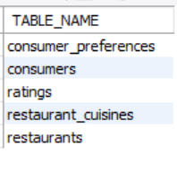
Database Tables
The Restaurant Database consists of 5 relational tables, each designed to manage a specific type of information.
Tables:
1. Consumers
Stores consumer demographic and personal preference-related information
2. Consumer_Preferences
Stores cuisines preferred by consumers
3. Restaurants
Stores restaurant details and location information
4. Restaurant_Cuisines
Stores cuisines offered by each restaurant
5. Ratings
Stores consumer ratings for restaurants

Slide 6
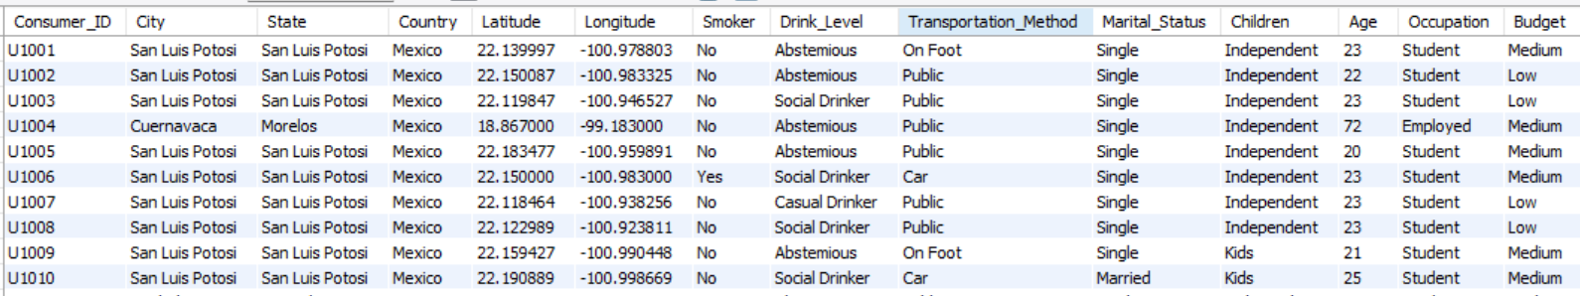
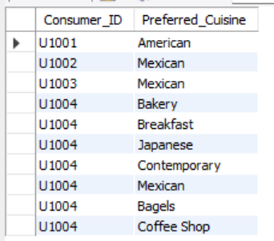
Sample Data - 1
Consumers & Consumer Preferences
Consumers Table
Stores consumer information such as:
  Consumer_ID
  City and State
  Age
  Occupation
  Budget
  Smoker
  Drink Level
  Transportation Method
Primary Key: Consumer_ID
Consumer_Preferences Table
Stores the cuisines preferred by each consumer
Connected to the Consumers table using Consumer_ID
Foreign Key: Consumer_ID

Slide 7
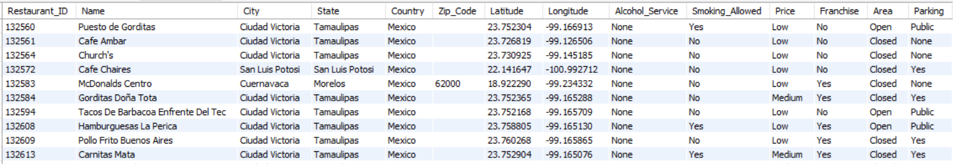
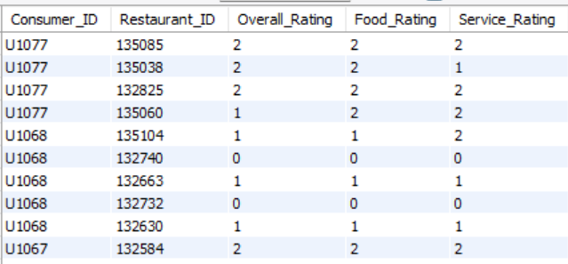
Sample Data - 2
Restaurants & Ratings
Restaurants Table
Stores restaurant information such as:
  Restaurant_ID
  Name
  City
  State
  Price
Primary Key: Restaurant_ID
Ratings Table
Stores ratings given by consumers
  Consumer_ID
  Restaurant_ID
  Overall_Rating
  Food_Rating
  Service_Rating
Foreign Keys:
Consumer_ID
Restaurant_ID

Slide 8
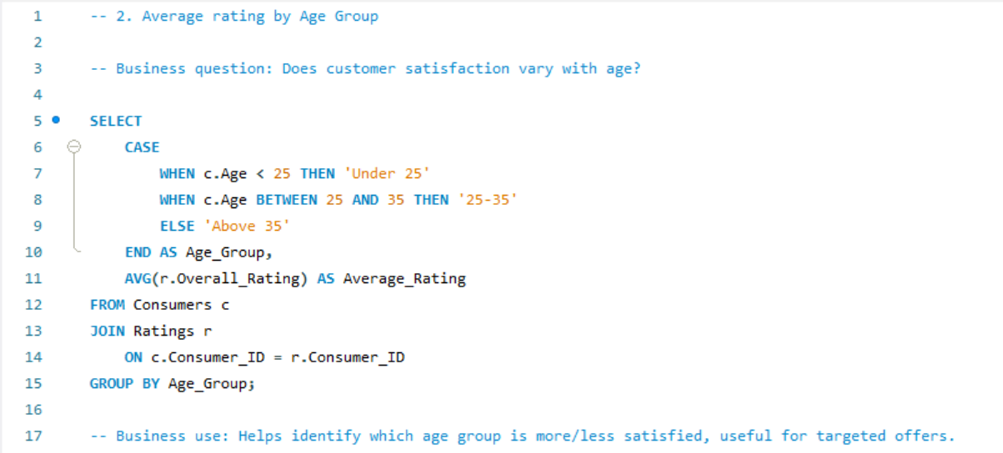
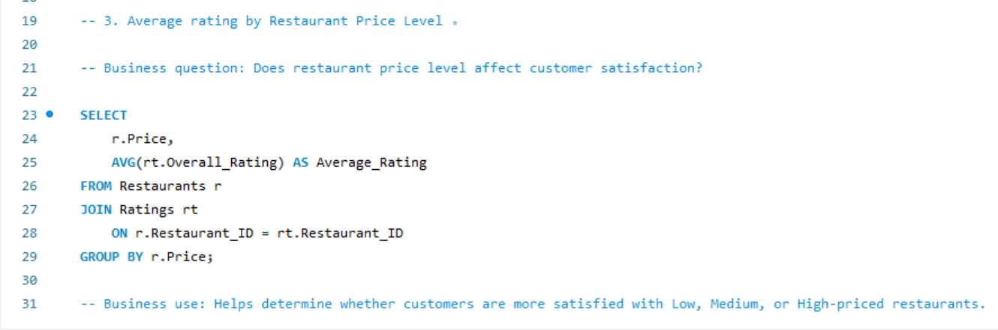
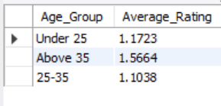
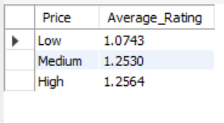
SQL Queries and Analysis

Slide 9
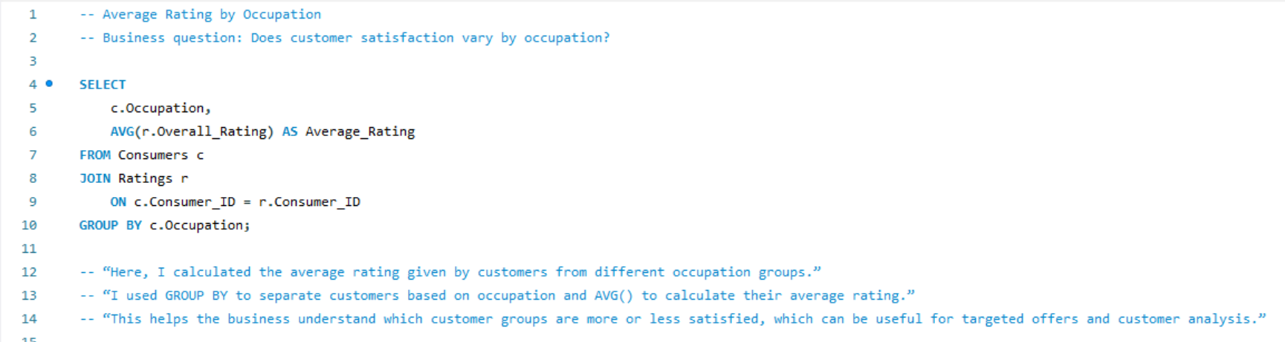
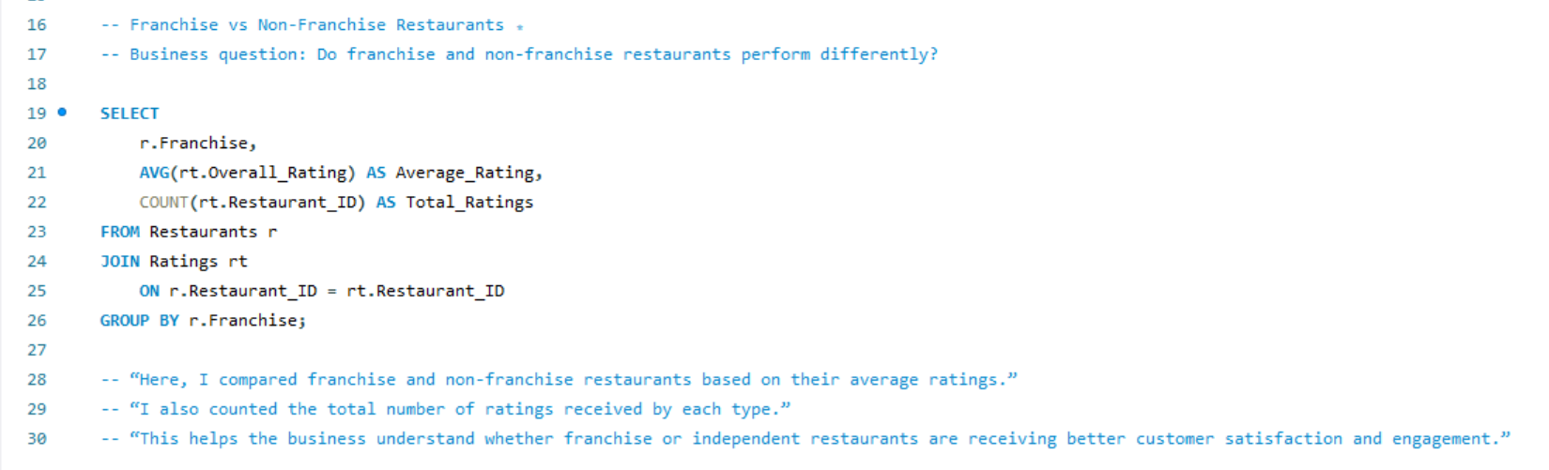
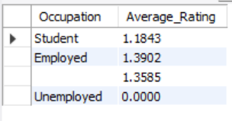
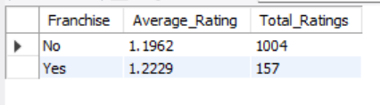

Slide 10
CONCLUSION
In conclusion, this Restaurant Database Management System demonstrates how SQL can be used to efficiently store, manage, retrieve, and analyse restaurant and consumer data.
The project helped me understand relational database design, Primary Keys, Foreign Keys, JOINs, GROUP BY, HAVING, Subqueries, CTEs, Window Functions, Views, and Stored Procedures.
This project improved my practical SQL skills and gave me a better understanding of how databases can be used to analyse real-world restaurant and consumer data.

Slide 11

THANK
YOU

